Slide 1
C++
Md. Abdur Rahman
Senior Computer Scientist
Centre for Advanced in Research in Sciences (CARS)
University of Dhaka

Slide 2
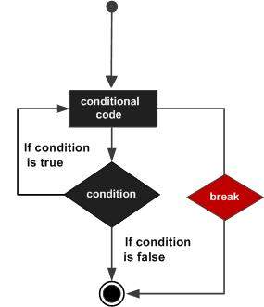
Break Statement
The C++ break is used to break loop or switch statement.
It breaks the current flow of the program at the given condition.
In case of inner loop, it breaks only inner loop.
jump-statement;
break;

Slide 3
Break Statement Example
#include <iostream>
using namespace std;
int main()
{
for (int i = 1; i <= 10; i++)
{
if (i == 5)
{
break;
}
cout<<i<<"\n";
}
}

Slide 4
Break Statement with Inner Loop
The C++ break statement breaks inner loop only if you use break statement inside the inner loop.
#include <iostream>
using namespace std;
int main()
{
for(int i=1;i<=3;i++)
{
for(int j=1;j<=3;j++)
{
if(i==2&&j==2)
{
break;
}
cout<<i<<" "<<j<<"\n";
}
}
}

Slide 5
Continue Statement
continue statement is used to continue loop
It continues the current flow of the program and skips the remaining code at specified condition
In case of inner loop, it continues only inner loop

Slide 6
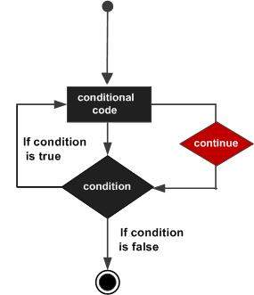
Continue Statement
jump-statement;
continue;
#include <iostream>
using namespace std;
int main()
{
for(int i=1;i<=10;i++)
{
if(i==5)
{
continue;
}
cout<<i<<"\n";
}
}

Slide 7
Continue Statement with Inner Loop
#include <iostream>
using namespace std;
int main()
{
for(int i=1;i<=3;i++)
{
for(int j=1;j<=3;j++)
{
if(i==2&&j==2)
{
continue;
}
cout<<i<<" "<<j<<"\n";
}
}
}

Slide 8
Goto Statement
The C++ goto statement is also known as jump statement.
It is used to transfer control to the other part of the program.
It unconditionally jumps to the specified label.
It can be used to transfer control from deeply nested loop or switch case label.

Slide 9
Goto Statement Example
#include <iostream>
using namespace std;
int main()
{
ineligible:
cout<<"You are not eligible to vote!\n";
cout<<"Enter your age:\n";
int age;
cin>>age;
if (age < 18)
{
goto ineligible;
}
else
{
cout<<"You are eligible to vote!";
}
}

Slide 10
Write program to solve the following problems
Display the half pyramid of * using nested-for loop
Display Floyd’s Triangle using nested-for loop
Display the Number Triangle using nested-for loop – I
Display the Number Triangle using nested-for loop – II
* * * * * * * * * *
1 2 2 3 3 3 4 4 4 4 5 5 5 5 5
1 1 2 1 2 3 1 2 3 4 1 2 3 4 5
1 2 3 4 5 6 7 8 9 10

Slide 11
Half pyramid of *
#include<iostream>
using namespace std;
int main()
{
int rows,i,j;
cout<<"Enter number of rows: ";
cin>>rows;
for(i=1;i<=rows;i++)
{
for(j=1;j<=i;j++)
{
cout<<"*";
}
cout<<endl;
}
return 0;
}
* * * * * * * * * *

Slide 12
Floyd’s Triangle
#include<iostream>
using namespace std;
int main()
{
int rows,i,j,k=1;
cout<<"Enter number of rows: ";
cin>>rows;
for(i=1;i<=rows;i++)
{
for(j=1;j<=i;j++)
{
cout<<k<<" ";
k++;
}
cout<<endl;
}
return 0;
}
1 2 3 4 5 6 7 8 9 10

Slide 13
Number Triangle using nested-for loop – I
#include<iostream>
using namespace std;
int main()
{
int i,j,n;
cout<<"Enter the value of n : ";
cin>>n;
cout<<"The number triangle :\n";
for(i=1;i<=n;i++)
{
for(j=1;j<=i;j++)
{
cout<<i<<" ";
}
cout<<endl;
}
return 0;
}
1 2 2 3 3 3 4 4 4 4 5 5 5 5 5

Slide 14
Number Triangle using nested-for loop – II
#include<iostream>
using namespace std;
int main()
{
int i,j,n;
cout<<"Enter the value of n : ";
cin>>n;
cout<<"The number triangle :\n";
for(i=1;i<=n;i++)
{
for(j=1;j<=i;j++)
{
cout<<j<<" ";
}
cout<<endl;
}
return 0;
}
1 1 2 1 2 3 1 2 3 4 1 2 3 4 5

Slide 15
Function
A function is a group of statements that together perform a task
Every C++ program has at least one function, which is main()
The function in C++ language is also known as procedure or subroutine in other programming languages.
It provides modularity and code reusability.

Slide 16
Function advantages
Code Reusability
By creating functions in C++, you can call it many times. So we don't need to write the same code again and again.
Code optimization
It makes the code optimized, we don't need to write much code.
e.g: check 3 numbers (531, 883 and 781) whether it is prime number or not
if you use functions, you need to write the logic only once and reuse it several times.

Slide 17
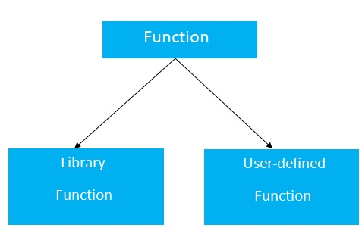
Types of Functions
Library Functions
which are declared in the C++ header files such as ceil(x), cos(x), exp(x), etc.
User-defined functions
which are created by the C++ programmer, so that he/she can use it many times. It reduces complexity of a big program and optimizes the code.

